Slide 1
Just Do It
How analysing a real data set that interested me taught me more than I intended to learn.

Slide 2

Notes:
I’ve been working in IT as BA for last 18 years and I’ve decided that I’d like to switch to data science
So I’ve been learning R in my spare time and I’ll be starting a Masters in Data Science in September
I’m here today because I thought it might be useful to share what I’ve been doing in case its useful to other R newbies.
I’ve found that even though online courses, tutorials, books, podcasts are all great, I’ve learned so much more from getting stuck in with analysing data I’m really interested in, and I’ve enjoyed it a lot more too.
So today I’m going to show you my first unguided R project which is an online report I created showing my analysis on US mass shootings
When I started out I just wanted to use the data set to practice cleaning data and also to learn how to create different types of charts beyond the simple bar chart and line graph, so I started out writing an R script in RStudio, but during the analysis I decided I wanted to find a way to publish my analysis so that I could share what I’d built as I thought it would be useful when I come to start looking for a job, and I wanted to make it look good. So in trying to achieve that, thats when I learned about RMarkdown, CSS and RPubs.
So I’ll show you a bit about R markdown, CSS, RPubs and GitHub
But first I’ll show you the end result...it’s probably amateur stuff for most of you people but I’m really chuffed with it

Slide 3

Notes:
http://rpubs.com/foxnic/shootings_v1

Slide 4
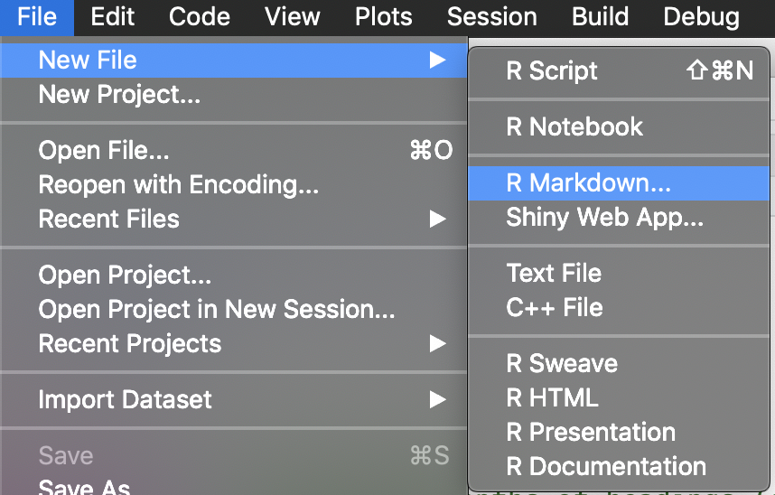
R Markdown - New File

Slide 5
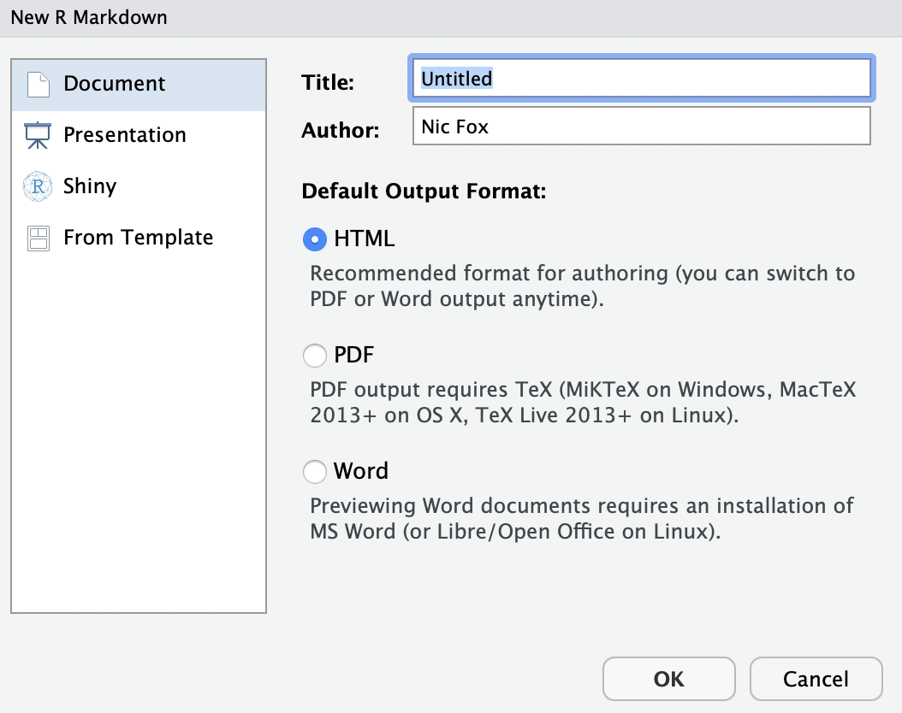
R Markdown - New File

Slide 6
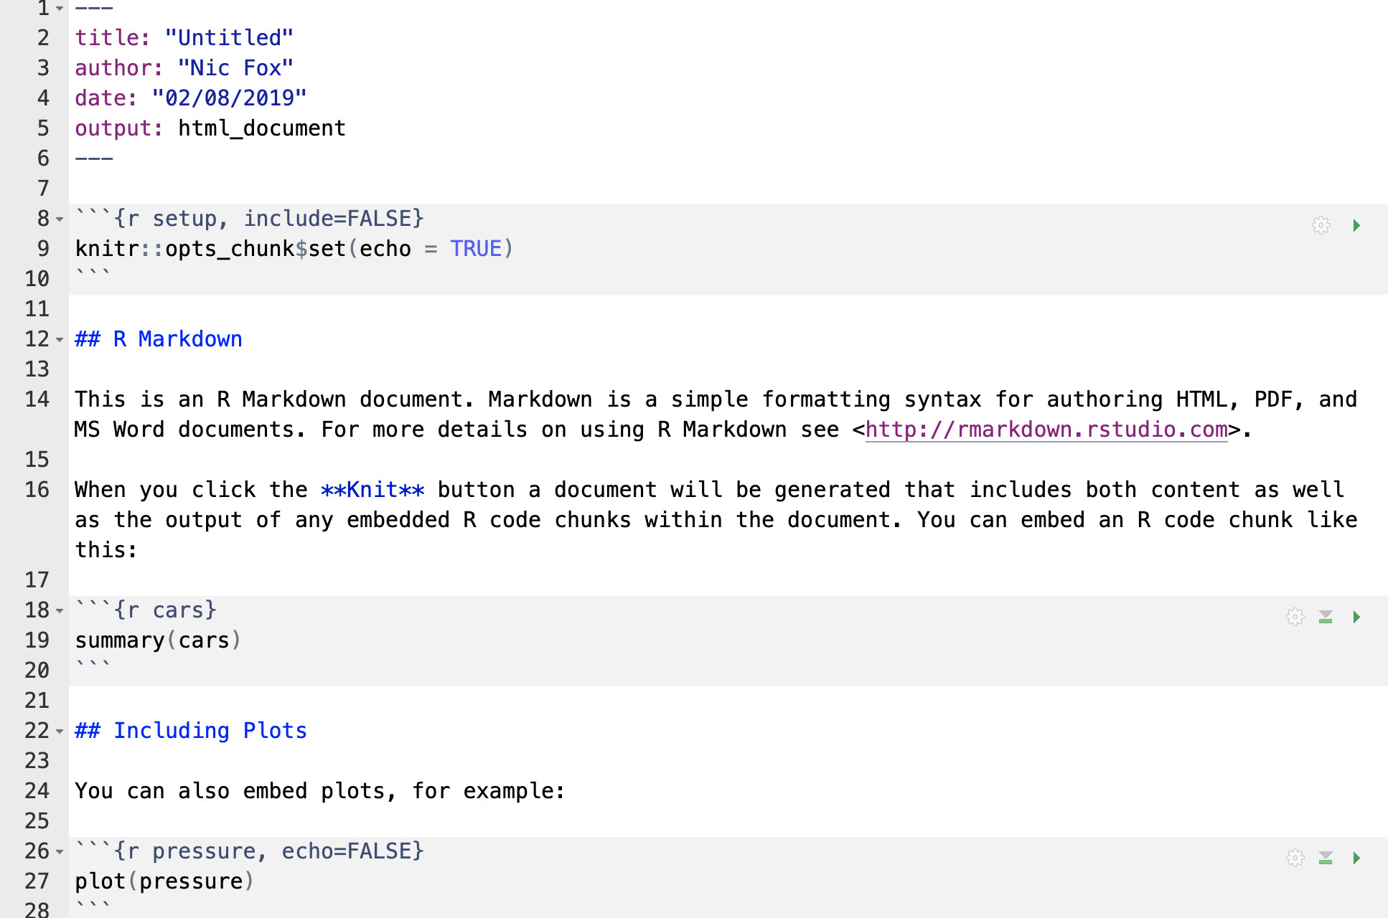
R Markdown - New File

Slide 7
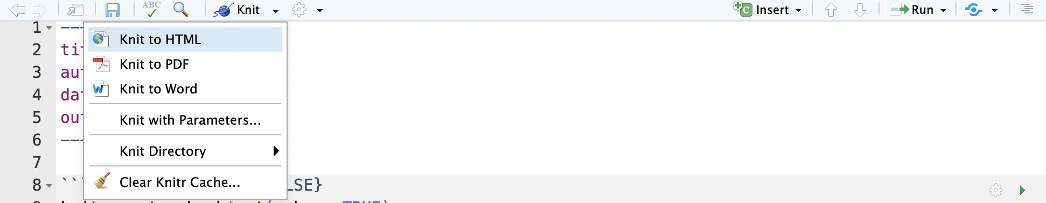
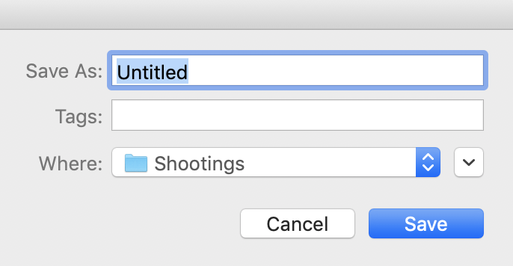
R Markdown - Knit to HTML

Slide 8
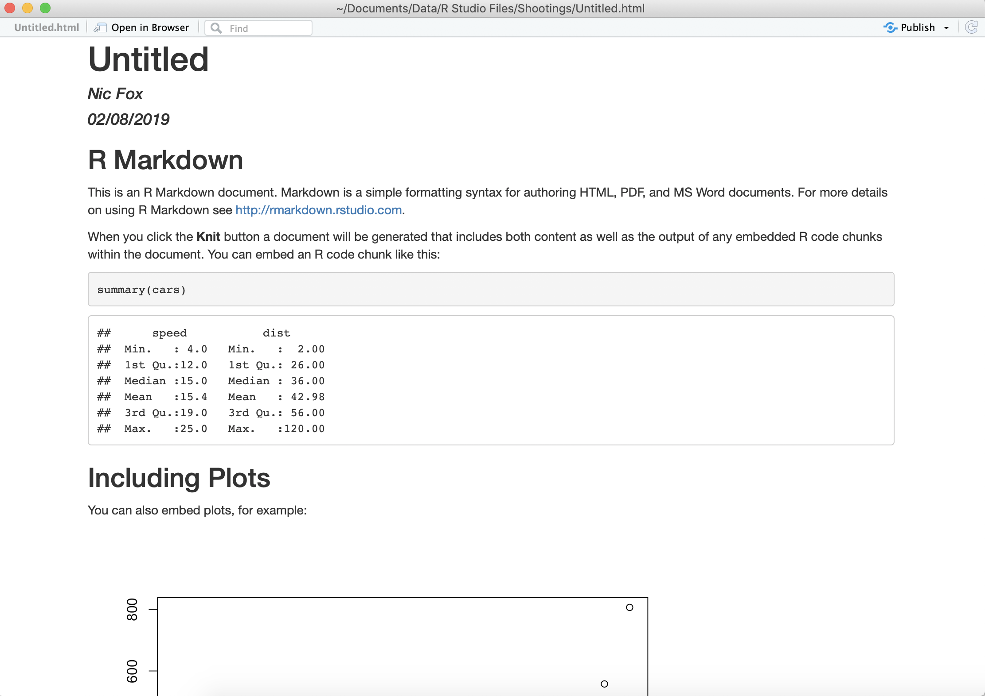
R Markdown - Knit to HTML

Slide 9
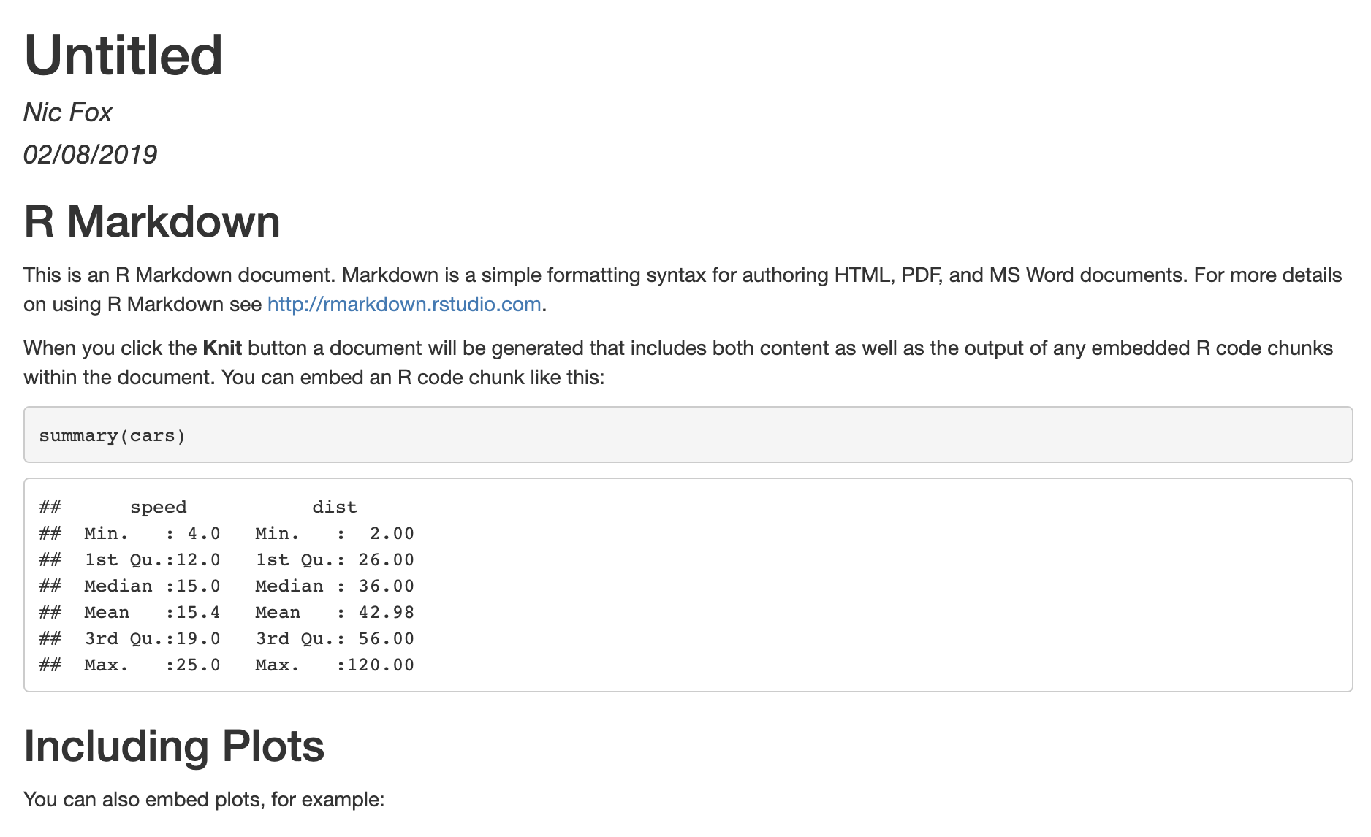
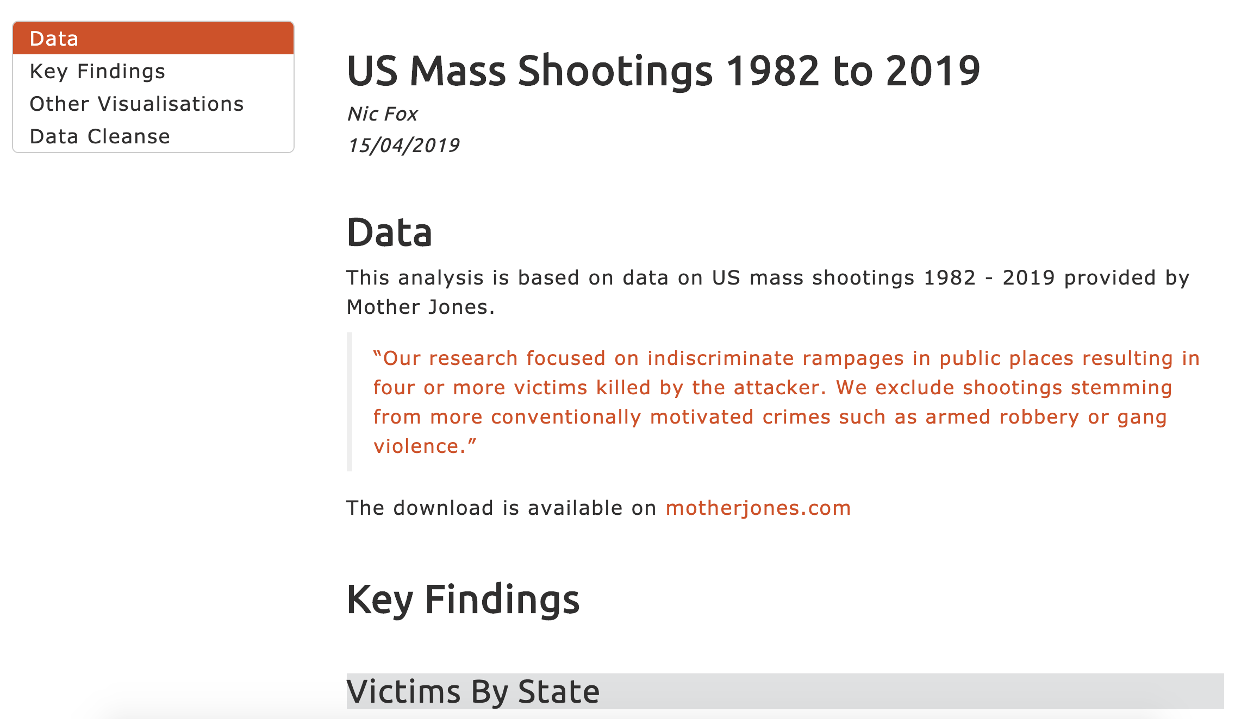
R Markdown - Default vs Custom

Slide 10
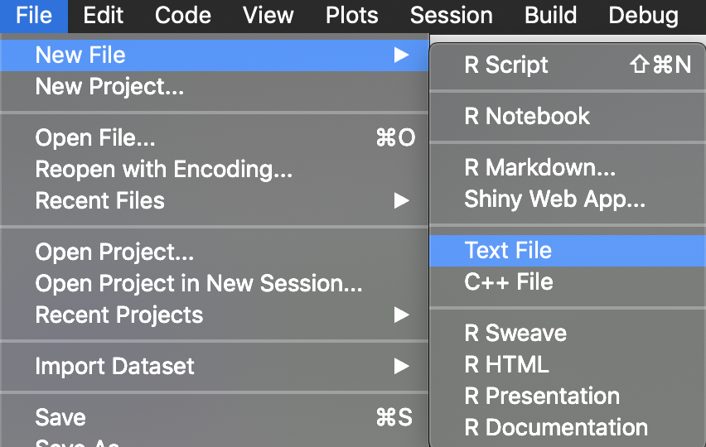
Customising R Markdown - New CSS File

Slide 11
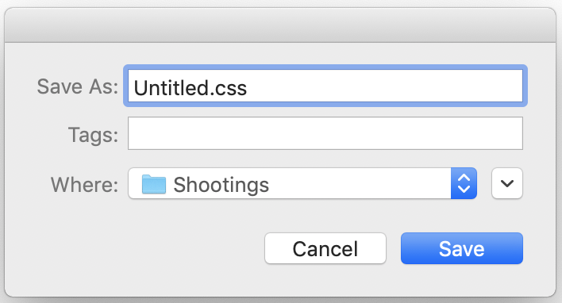
Customising R Markdown - New CSS File

Slide 12
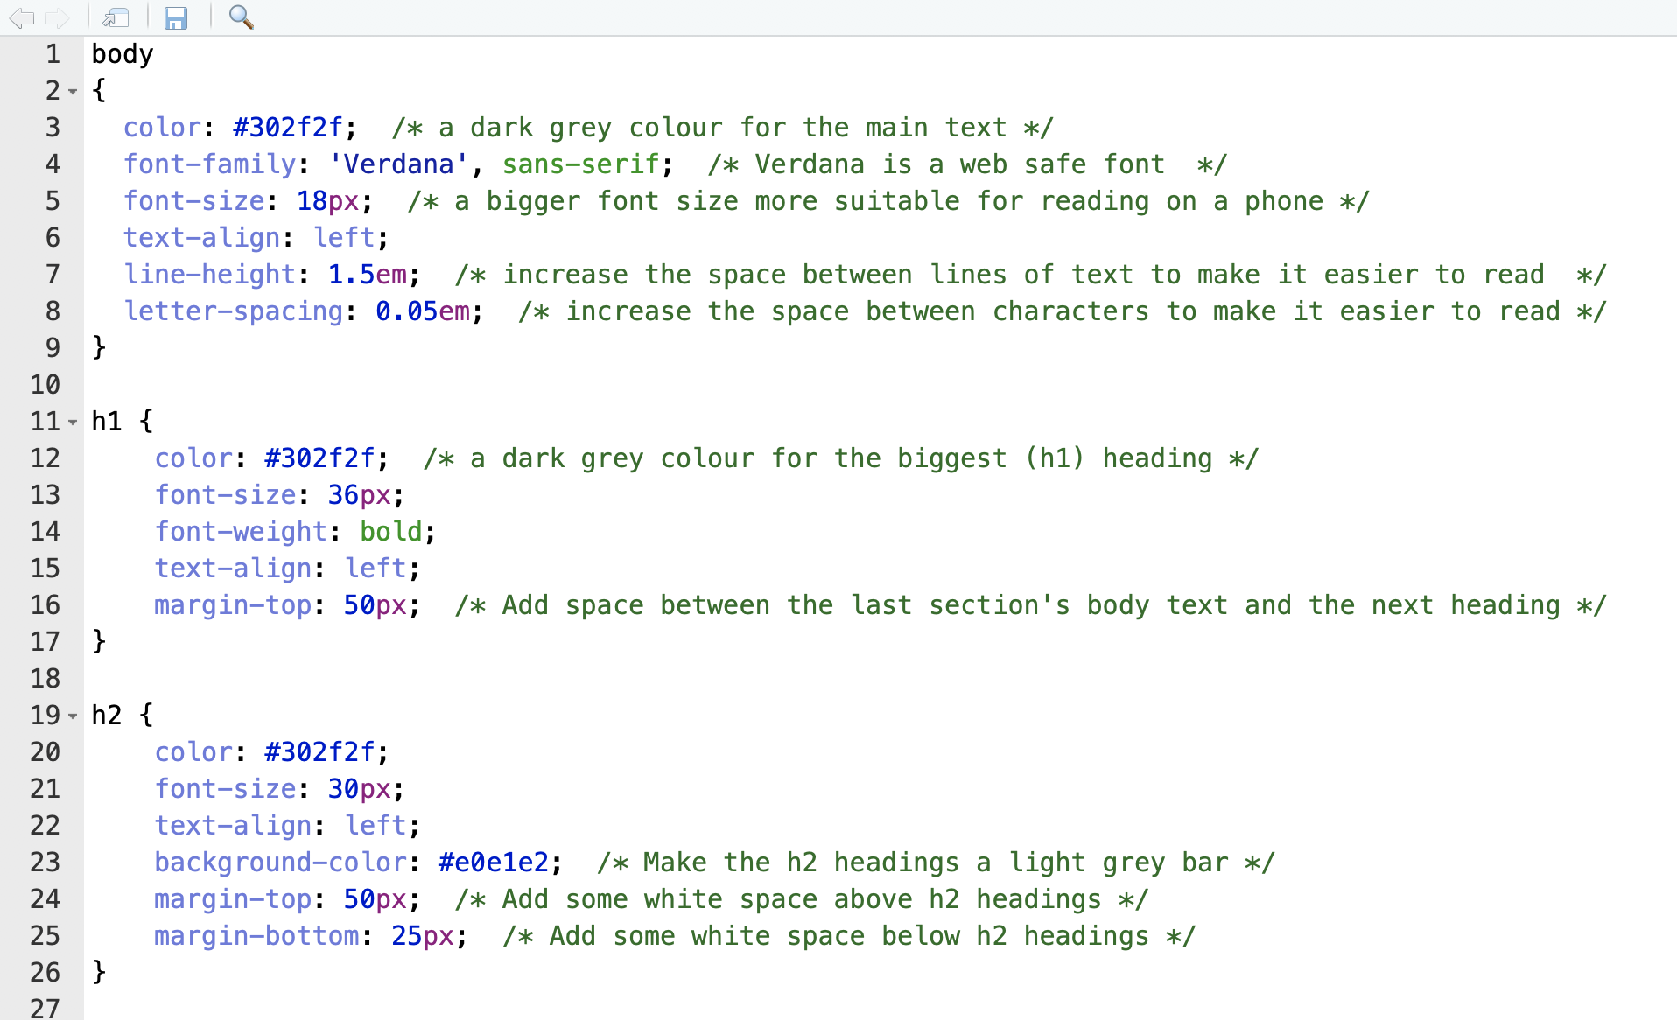
Customising R Markdown - CSS

Slide 13
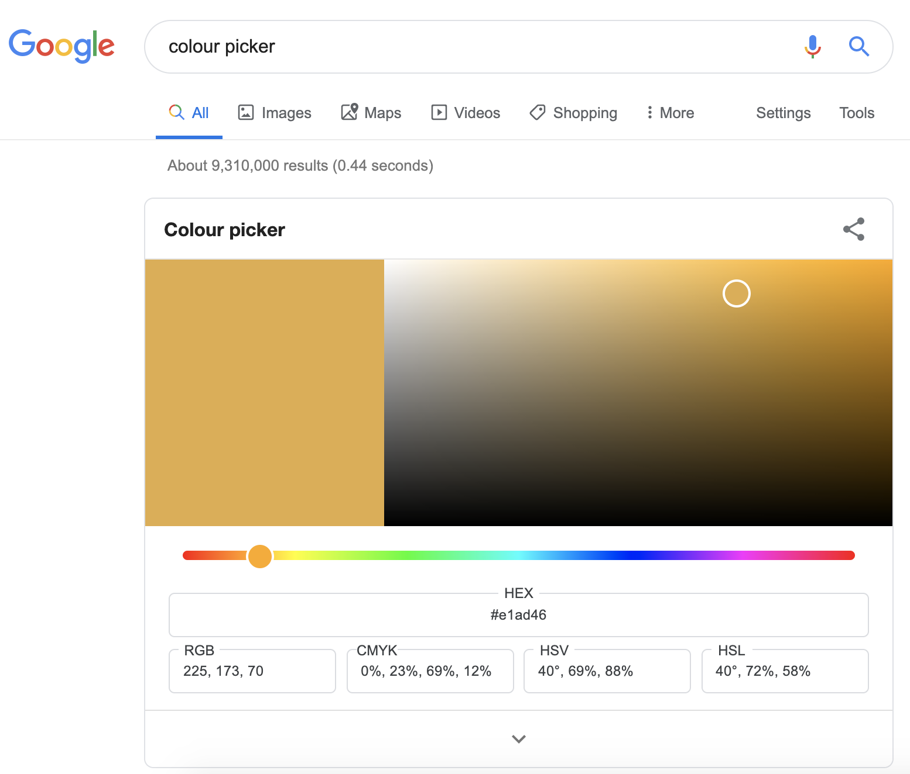
Customising R Markdown - Choosing Colours

Slide 14
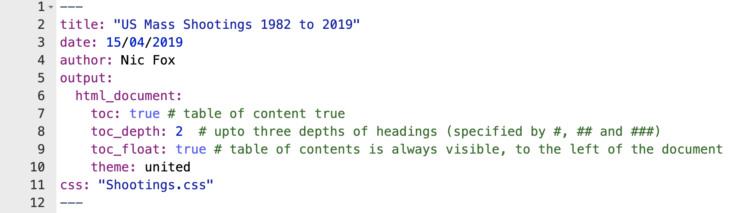
Customising R Markdown - R Markdown File

Slide 15
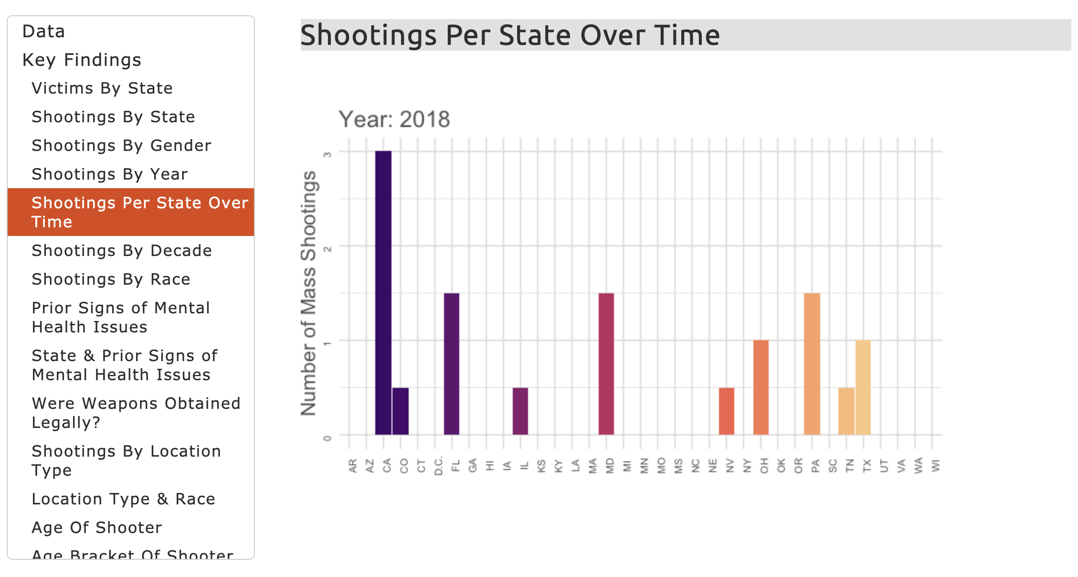
Customising R Markdown - Table of Contents (TOC)

Slide 16

Customising R Markdown - Themes
https://bookdown.org/yihui/rmarkdown/

Slide 17
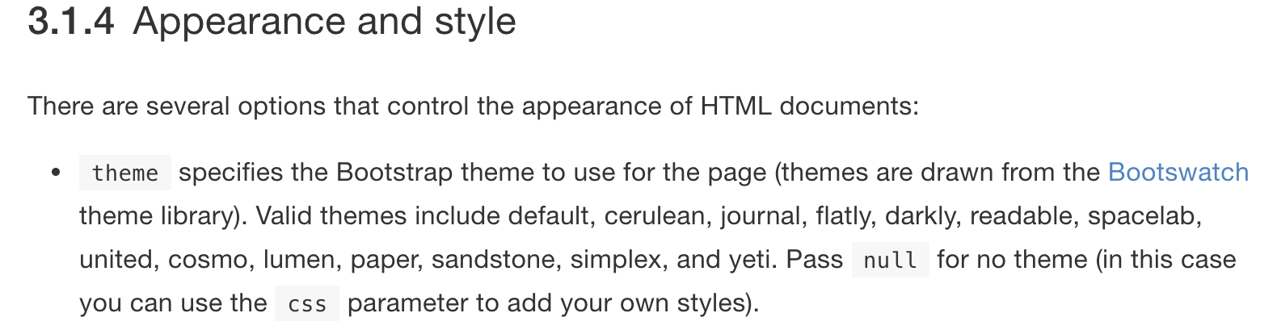
Customising R Markdown - Themes
https://bookdown.org/yihui/rmarkdown/html-document.html#appearance-and-style

Slide 18
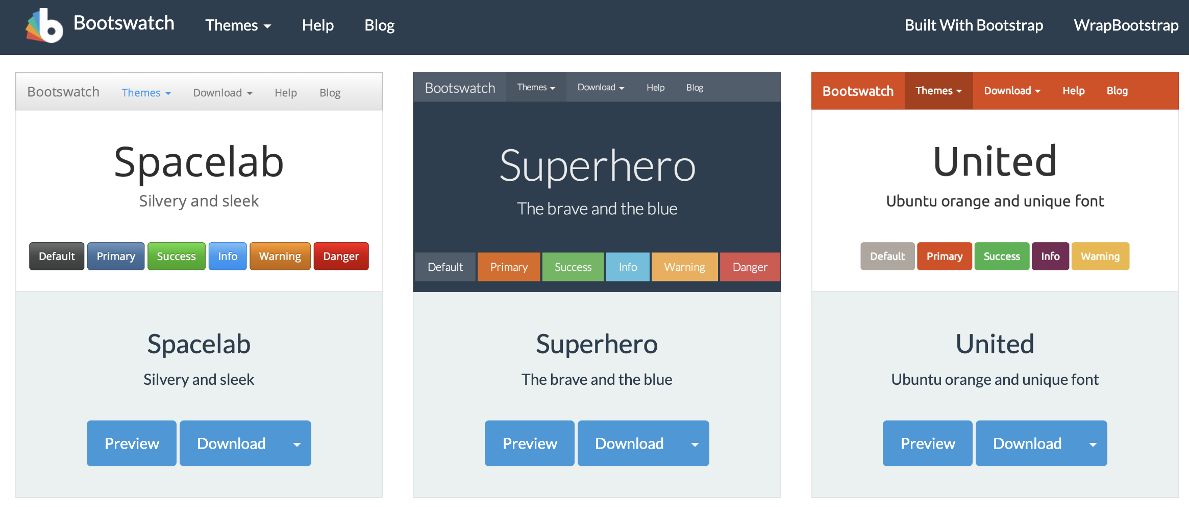
Customising R Markdown - Themes
https://bootswatch.com/3/

Slide 19
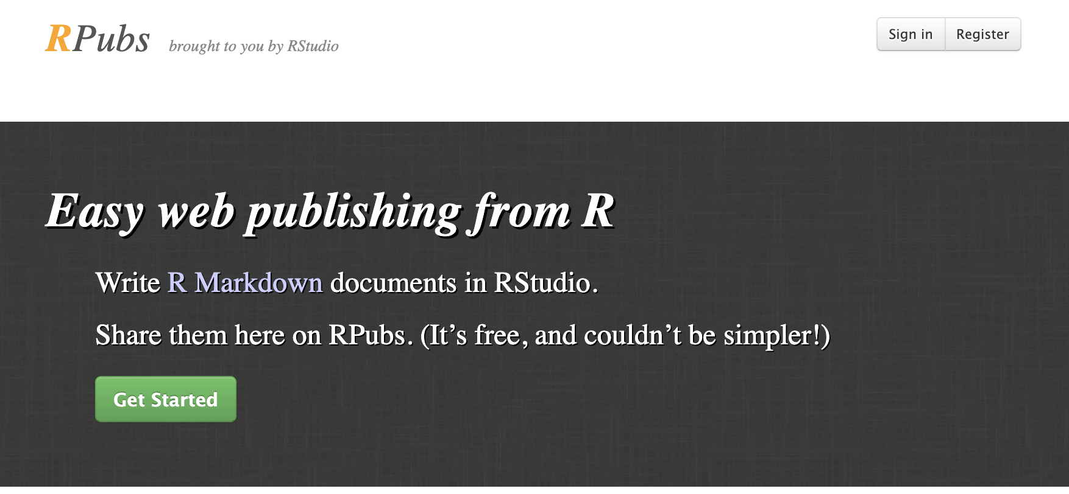
Publishing R Markdown HTML - RPubs.com

Slide 20
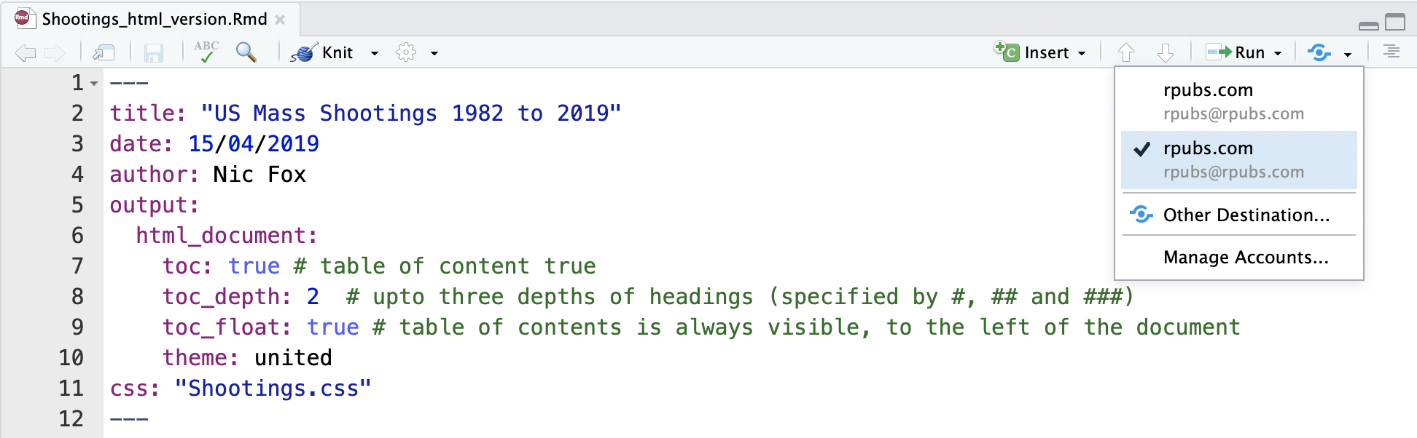
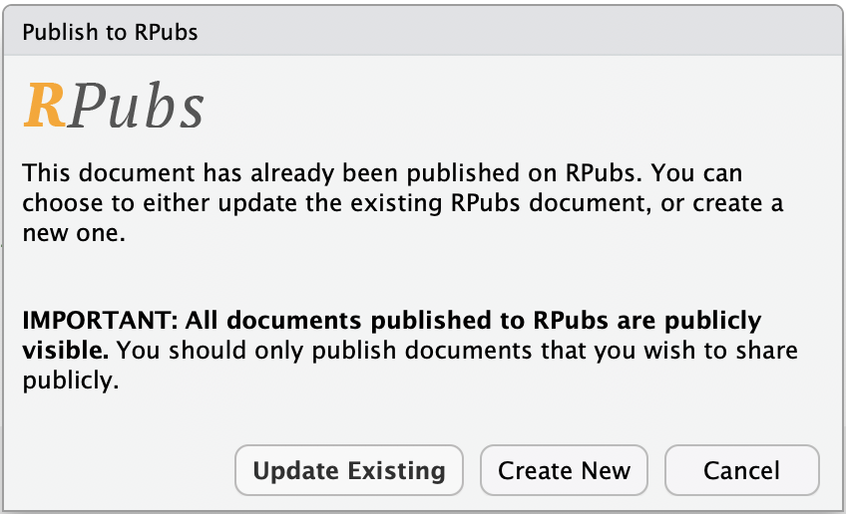
Publishing R Markdown HTML - RPubs.com

Slide 21
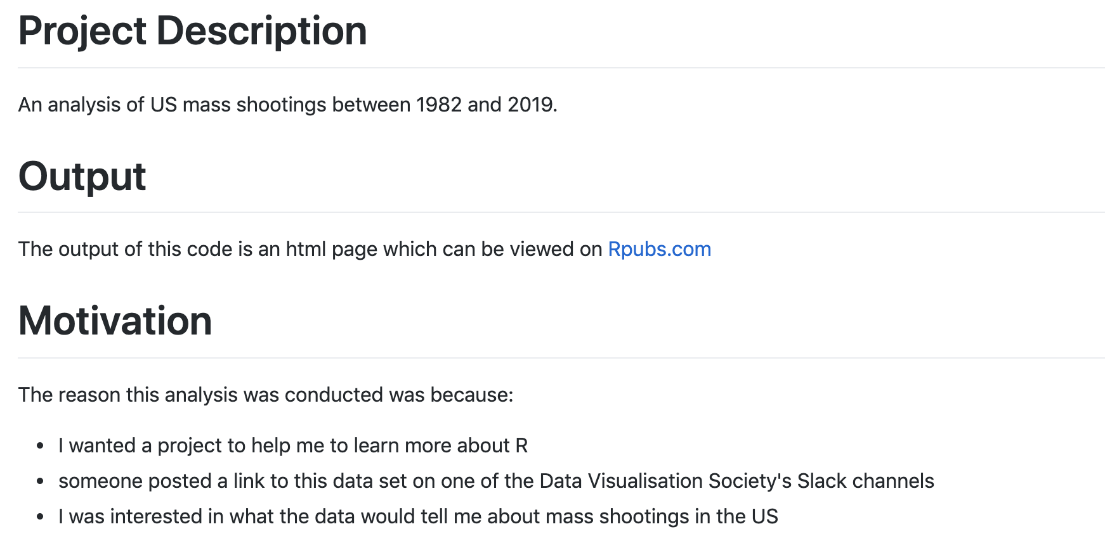
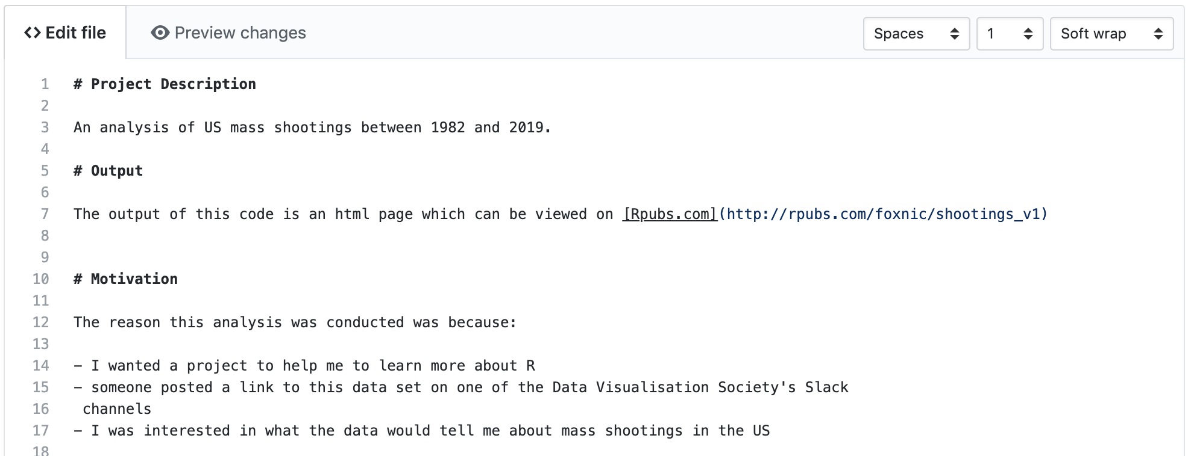
Markdown in GitHub - README

Slide 22


Slide 23
temp2 <- temp1
%>% select(state, race, for_count)
%>% group_by(state, race)
%>% summarise(num_shootings = sum(for_count))
Error in summarise(num_shootings = sum(for_count)) : object 'for_count' not found

Slide 24
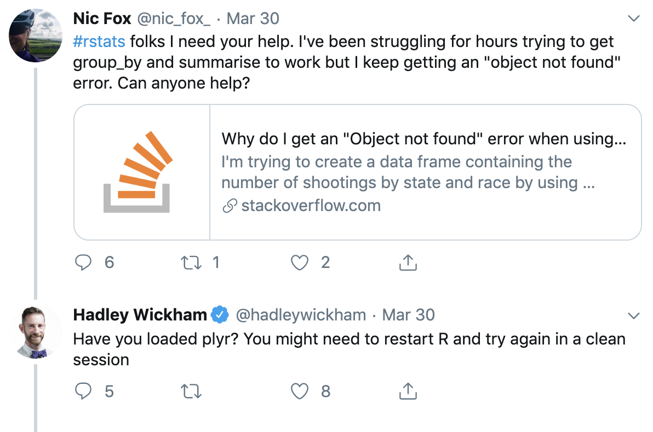

Slide 25
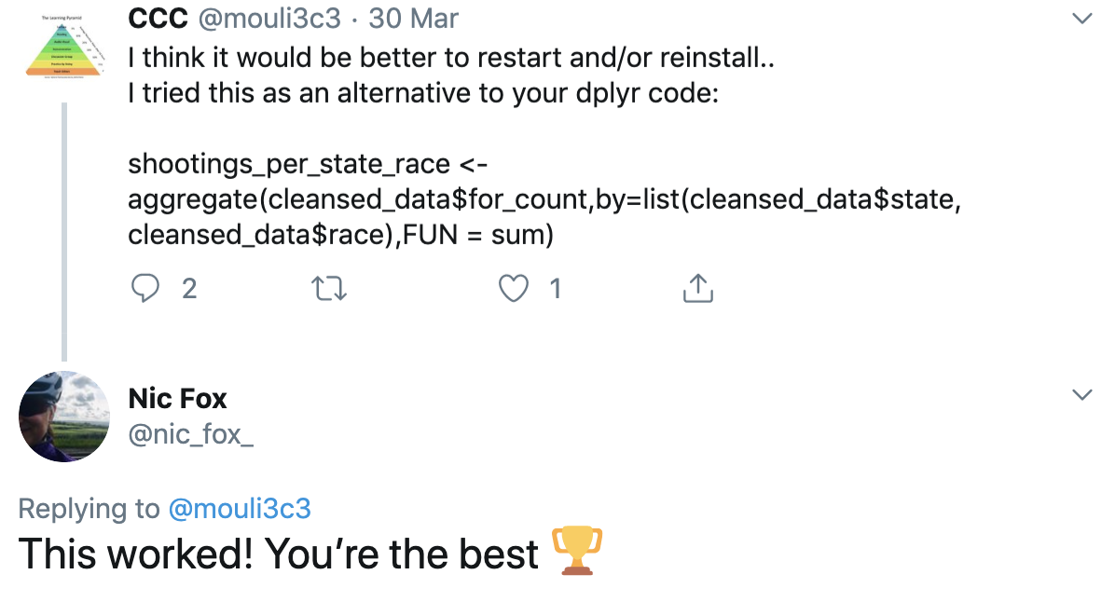

Slide 26
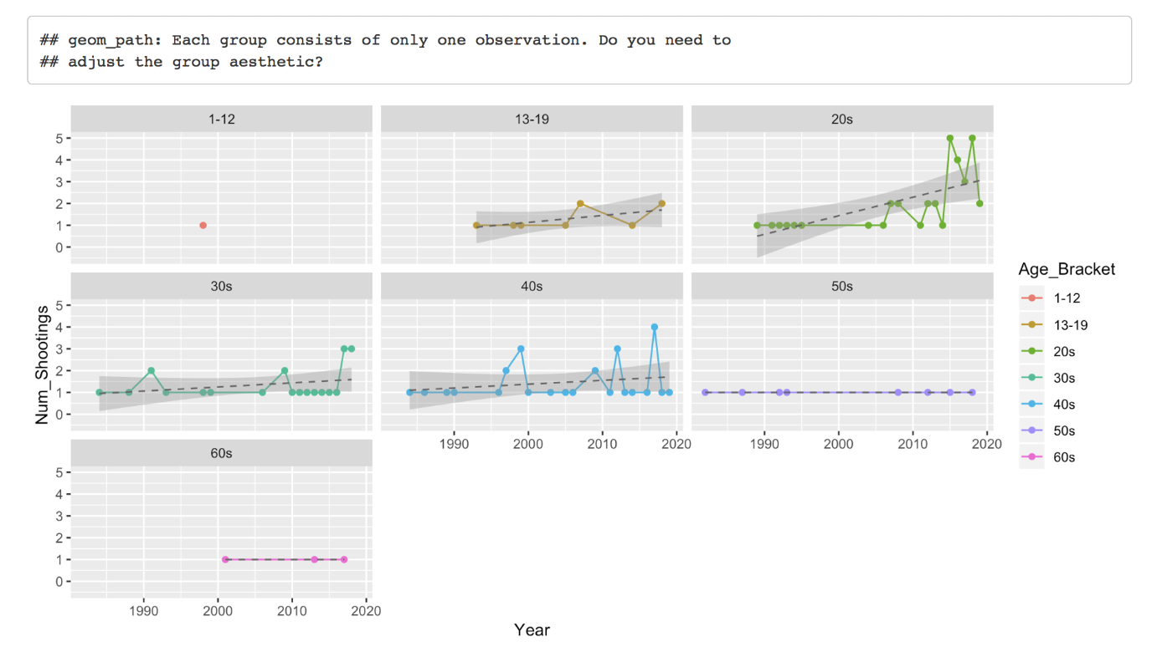

Slide 27
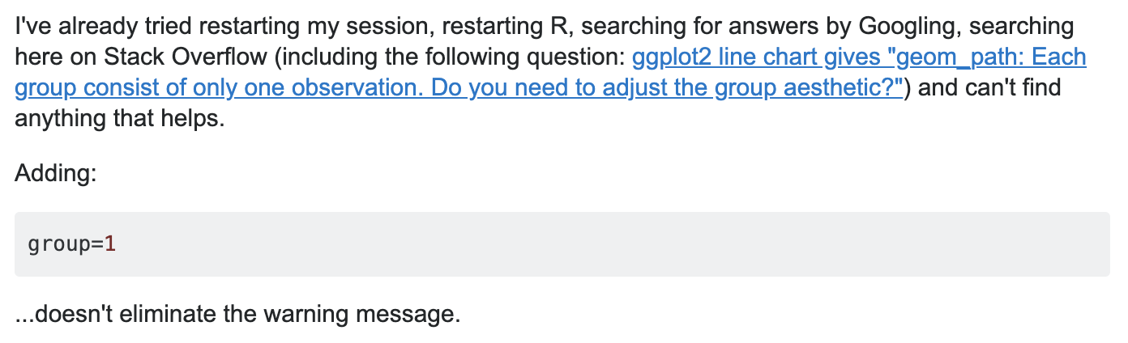


Slide 28
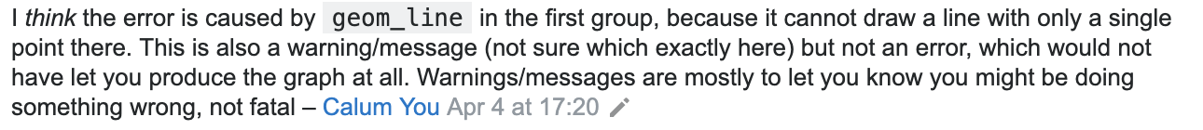
StackOverflow actually helped this time...

Slide 29
R
#Rstats
CSS
RStudio
RPubs
GitHub
R Markdown

Slide 30


foxnic
github.com/foxnic/US-Mass-Shootings-Analysis
@nicfoxds

